Slide 1
Chapter 11
What Works and What Doesn’t

Slide 2
Are Hospitals Good for You?
From Angrist and Pischke, Mostly Harmless Econometrics

Slide 3
What Is a Treatment Effect?
So T means you’re in the treatment group (went to hospital), and Y_{0,T} is what your Y would have been if the treatment hadn’t happened (we can’t see this)

Slide 4
What Can We See?
What your outcome is with the treatment (Y_{1,T})
The outcome for others who were not treated, even though you were (Y_{1,NT})
In our hospital example, the second may be different kinds of people than you!

Slide 5
The Selection Problem (you can’t see what didn’t happen)
<0 in our hospital example (why?)

Slide 6
Randomized Experiments
Randomization makes getting the treatment independent of what your Y_{0T} is
It’s like randomly sending some people to hospital and others not, then comparing their health afterwards
This makes…

Slide 7

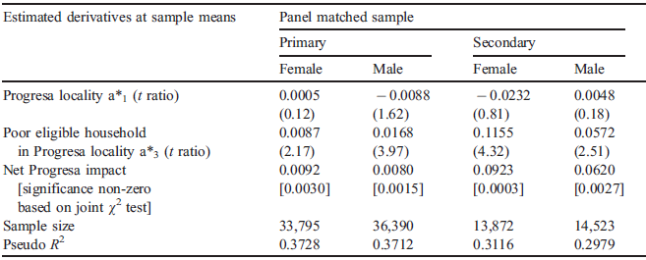
Consider PROGRESA
T. Paul Schultz. 2004. School Subsidies for the Poor: Evaluating the Mexican PROGRESA Poverty Program. JDE 74(199-250)
Enrollment in school of kid i at time t (S_{it}=1 if enrolled, 0 otherwise):
Really Shouldn’t Matter
P_{i}: Kid i in randomly assigned PROGRESA village; E_{i}: eligibility dummy
T. Paul Schultz. 2004. School Subsidies for the Poor: Evaluating the Mexican PROGRESA Poverty Program. JDE 74(199-250)

Slide 8
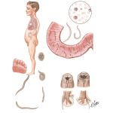

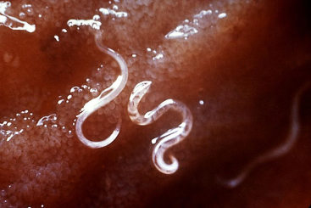



What better way to start out than with…
Helminths

Slide 9
The Problem
Hookworm and roundworm each infect approximately 1.3 billion people around the world
while whipworm affects 900 million and 200 million are infected with schistosomiasi

Slide 10
The Other Problem
Intense worm infections reduce kids’ educational achievement

Slide 11

An Experiment in Kenya
Randomly treat all kids in some schools
..but not other schools (the control group)
Then see if school attendance goes up for the kids in the treated schools

Slide 12

Clean, Straightforward. but…
The treated schools “treated” the control schools
…making it harder to show the treatment worked
Edward Miguel and Michael Kremer. “Worms: Identifying Impacts on Education and Health in the Presence of Treatment Externalities.” Econometrica 72(1, January):159-217, 2004

Slide 13
“The World Bank is finally embracing science.”
“Creating a culture in which rigorous randomized evaluations are promoted, encouraged, and financed has the potential to revolutionize social policy during the 21st century, just as randomized trials revolutionized medicine during the 20th.”
-Esther Duflo

Slide 14
Social Cash Transfers in Africa
Malawi: reduction in child morbidity, gains in school enrolment, increases in food consumption, decrease in child labor
Ethiopia: increase in school attendance for some groups, particularly younger children; reduction in male child labor
South Africa: increased school attendance, decreased hunger, increased access to cell-phone use and AIDS among school-age girls

Slide 15
Other Examples of Randomized Control Trials (Chapter 11)
Hope
AIDS
Vaccines (The Last Mile)
Worms
Credit
Insurance

Slide 16
The Skeptic
“In ideal circumstances, randomized evaluations of projects are useful for obtaining a convincing estimate of the average effect of a program or project.
The price for this success is a focus that is too narrow to tell us “what works” in development, to design policy, or to advance scientific knowledge about development processes.”
-Angus Deaton

Slide 17
We Need to Look Beyond Experiments when…
We need an ex-ante analysis, a design tool; no pilot rollout is possible
Treatment / control groups are impractical
  Logistical, political, ethical and financial realities
We want to know not only “if” but also “why” there are impacts
    Human beings are agents, not subjects
There are multiple treatments and inter-related outcomes
The impacts are heterogeneous, with winners and losers

Slide 18
Linkages and Worms
Linkages transmit impacts from the treatment group to others in the local population
…creating higher-level impacts

Slide 19








Transfer Policy

Slide 20
Transfer Policy
Treatment households adjust

Slide 21
Transfer Policy
External Linkages
…affecting other households

Slide 22
Transfer Policy
External Linkages
…which adjust

Slide 23
Transfer Policy
External Linkages
…affecting still other households

Slide 24
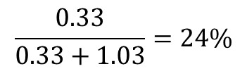
Effect on Household Incomes
Treated Household Income | Multiplier
nominal | 1.15
cpi increase in % | 1.96%
real | 1.03
Non-treated Household Income
nominal | 1.08
cpi increase in % | 1.88%
real | 0.33
$$\frac{0.33}{0.33+1.03}=24\%$$

Slide 25
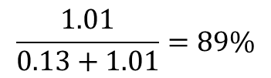
Effects on Production
Production multiplier for: | Treated HH (24% pop) | Nontreated HH (76% pop)
Crop | 0.03 | 0.15
Livestock | 0.02 | 0.26
Retail | 0.07 | 0.52
Services | 0 | 0.08
Other Production | 0 | 0
TOTAL | 0.13 | 1.01
$$\frac{1.01}{0.13+1.01}=89\%$$

Slide 26
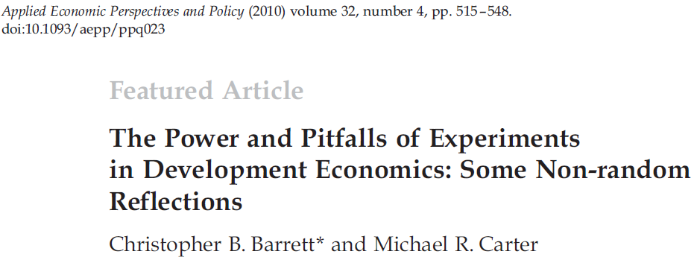
The Ethics of Randomized Control Trials

Slide 27
1. Do No Harm?
Gugerty and Kremer (2008) tests whether grants of money to women’s organizations in Kenya distorts them and leads to the exclusion of poorer women and their loss of benefits (Answer: yes. Experiment arguably hurt poor women to show this.)
Randomly giving loans to people who don’t qualify

Slide 28
2. Informed Consent
Individuals are often unaware that they are (or are not) part of an experiment
Biomedical researchers have given this issue much thought, but development economists less so

Slide 29
3. Unblindedness
Those who know themselves to be in a control group may suffer emotional distress
  …which can have adverse biophysical consequences that exaggerate the differences between control and treatment groups
But does blindedness make sense in economic experiments?

Slide 30
4. The Ethics of Not Targeting
Randomized interventions treat individuals who don’t need the treatment
  …wasting scarce resources
  …and encouraging project implementers to violate the randomized research design
This raises ethical questions and makes it hard to keep the experiment “clean”
  It’s easy to lose control of the experiment

Slide 31
Other Problems
Just because a treatment is beneficial doesn’t mean it’s the best way to do something
…or that it will have the same benefits once you “ramp it up,” say, to all villages
Increasingly, people want to know the total impact, not just the “average effect of the treatment on the treated.”

